Slide 1
Preflow-Push Maximum-Flow Algorithm
Idea:
The Preflow-Push Algorithm increase the flow on an edge-by-edge basis.

Slide 2
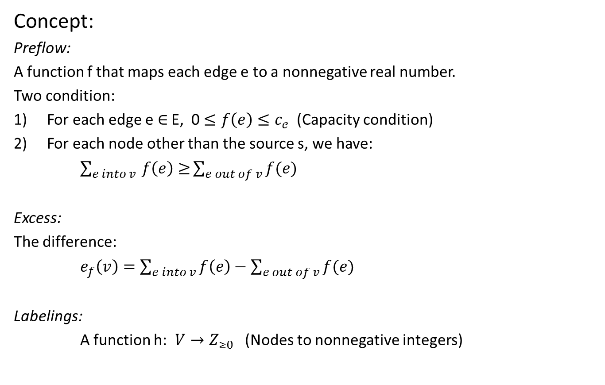
Preflow-Push Maximum-Flow Algorithm
Concept:
Preflow:
A function f that maps each edge e to a nonnegative real number.
Two condition:
For each edge e $∈$ E, 0 $≤f\left(e\right)≤c_{e}$ (Capacity condition)
For each node other than the source s, we have:
$\sum_{e into v }{f\left(e\right)≥}\sum_{e out of v}{f(e)}$
Excess:
The difference:
$e_{f}\left(v\right)=\sum_{e into v}{f\left(e\right)−\sum_{e out of v}{f(e)}}$
Labelings:
A function h: $V→Z_{≥0}$ (Nodes to nonnegative integers)

Slide 3
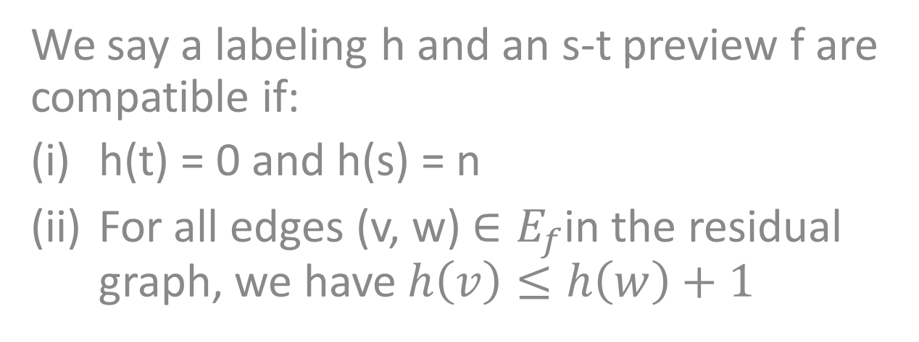
Preflow-Push Maximum-Flow Algorithm
We say a labeling h and an s-t preview f are compatible if:
h(t) = 0 and h(s) = n
For all edges (v, w) $∈E_{f}$in the residual graph, we have $h\left(v\right)≤h\left(w\right)+1$

Slide 4
Preflow-Push Maximum-Flow Algorithm
Property:
(7.21) If s-t preflow f is compatible with a labeling h, then there is no s-t path in the residual graph Gf.
(7.22) If s-t flow f is compatible with a labeling h, then f is a flow of maximum value.

Slide 5
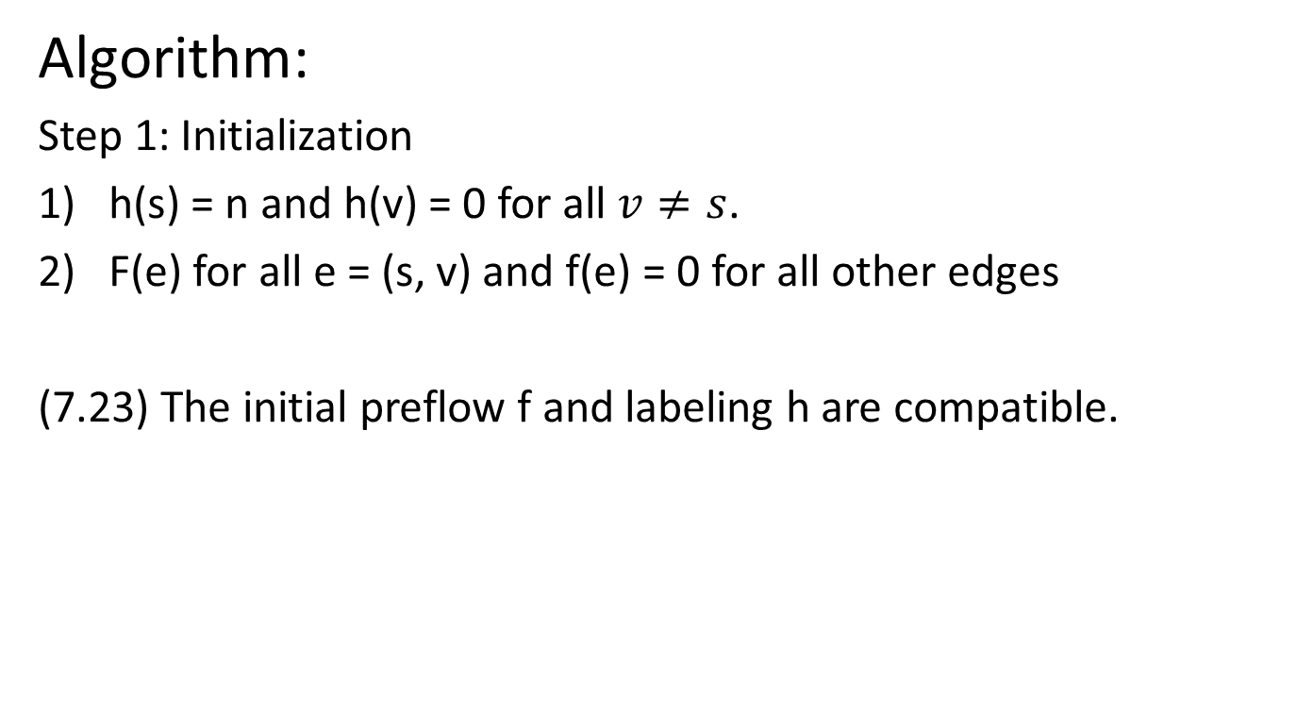
Preflow-Push Maximum-Flow Algorithm
Algorithm:
Step 1: Initialization
h(s) = n and h(v) = 0 for all $v≠s$.
F(e) for all e = (s, v) and f(e) = 0 for all other edges
(7.23) The initial preflow f and labeling h are compatible.

Slide 6
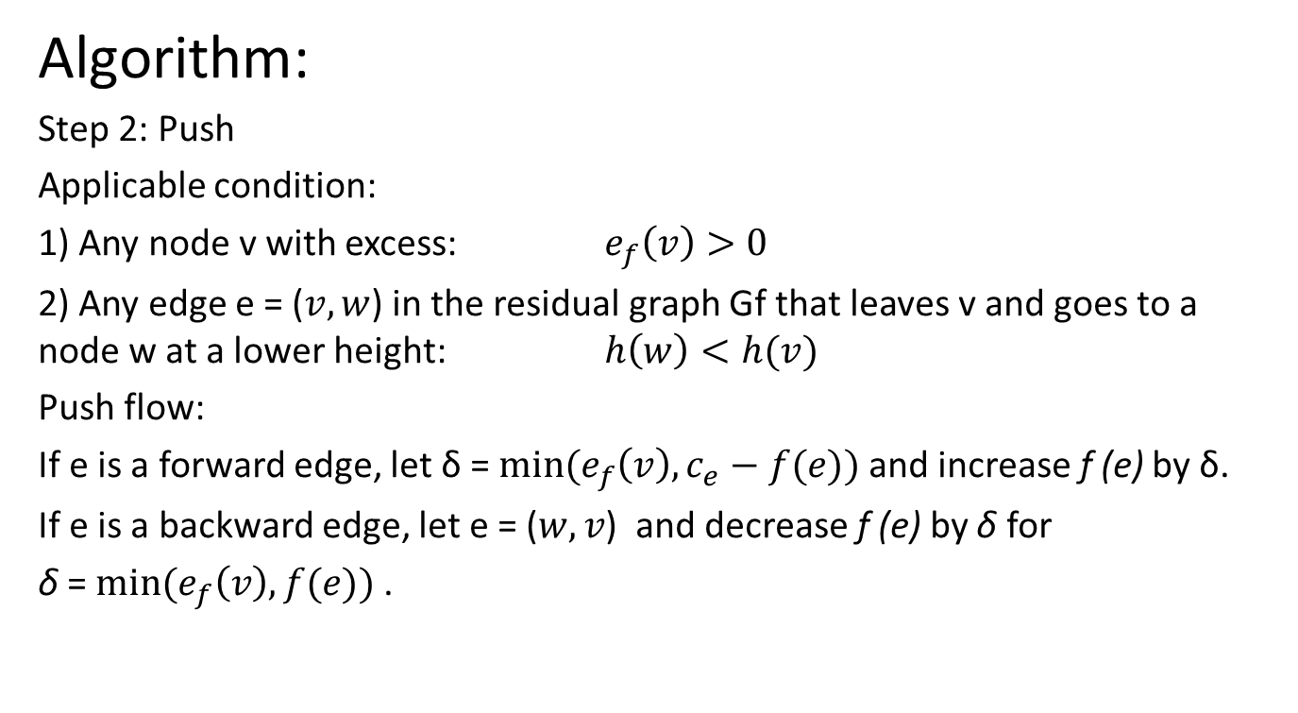
Preflow-Push Maximum-Flow Algorithm
Algorithm:
Step 2: Push
Applicable condition:
1) Any node v with excess: $e_{f}\left(v\right)>0$
2) Any edge e = ($v,w$) in the residual graph Gf that leaves v and goes to a node w at a lower height: $h\left(w\right)<h(v)$
Push flow:
If e is a forward edge, let δ = $min⁡(e_{f}\left(v\right),c_{e}−f(e))$ and increase f (e) by δ.
If e is a backward edge, let e = ($w,v$) and decrease f (e) by δ for
δ = $min⁡(e_{f}\left(v\right), f(e))$ .

Slide 7
Preflow-Push Maximum-Flow Algorithm
Algorithm: Step 3: Relabel
Applicable condition: Any node v with excess and cannot push all edges leaving v
Then increase the height of v h(v) by 1.
Step 4: End
there are no nodes other than t with positive excess, and hence the preflow f is in fact a flow.

Slide 8
Preflow-Push Maximum-Flow Algorithm
Analysis of the algorithm: (i) The preflow f and labeling h are compatible during the algorithm.
By (7.23) the initial preflow f and labeling h are compatible. The relabel operation only applies when no edge leaving v in the residual graph is going downward, and hence the preflow f and the labeling h are compatible after relabeling.
(ii) If there is no node other than s and t has excess, then f is the max flow.
In this case, f is a flow. Since the flow and labeling f remains compatible, flow f is the max flow according to (7.22).

Slide 9
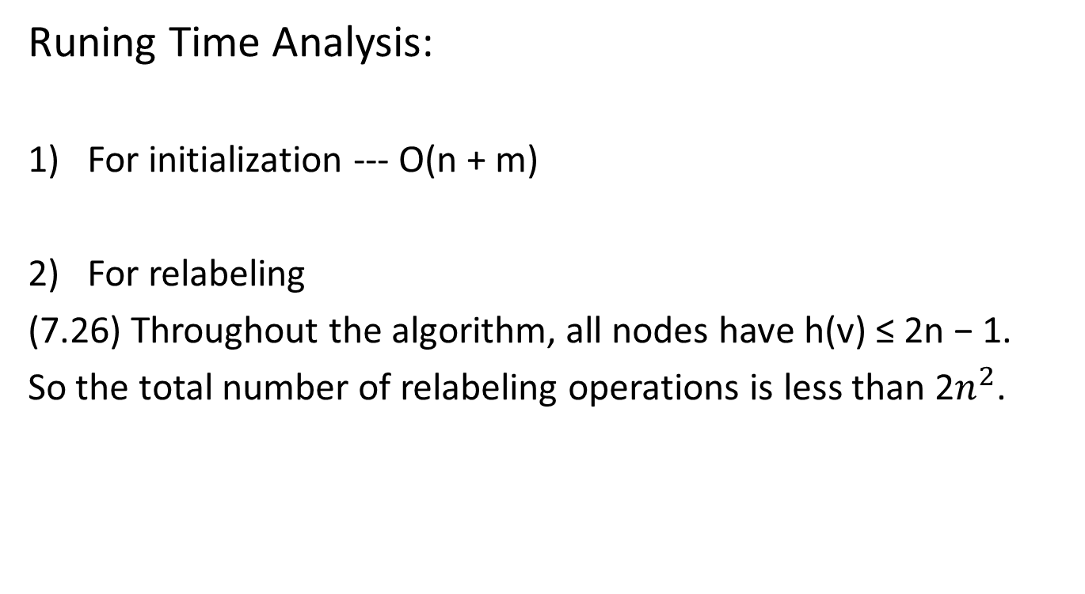
Preflow-Push Maximum-Flow Algorithm
Runing Time Analysis:
For initialization --- O(n + m)
For relabeling
(7.26) Throughout the algorithm, all nodes have h(v) ≤ 2n − 1.
So the total number of relabeling operations is less than 2$n^{2}$.

Slide 10
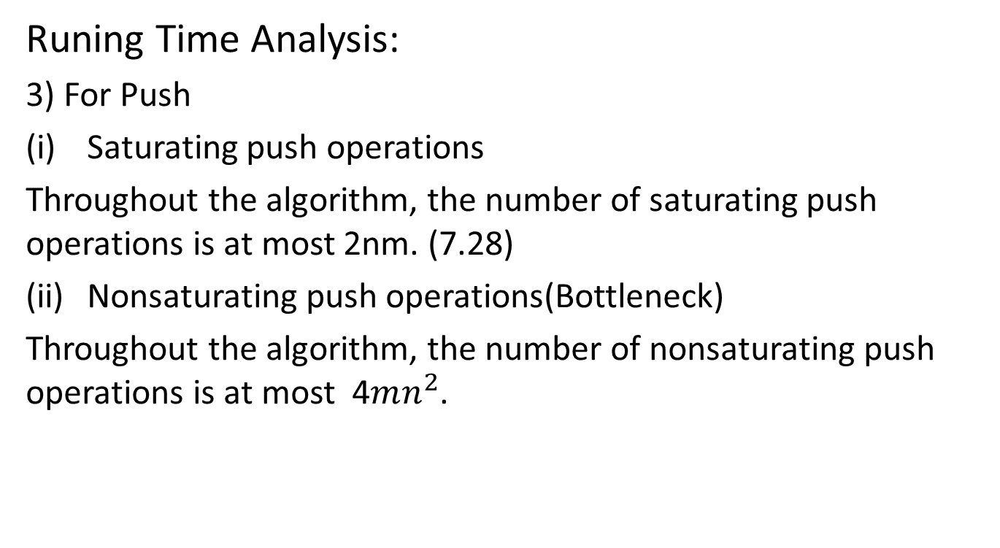
Preflow-Push Maximum-Flow Algorithm
Runing Time Analysis:
3) For Push
Saturating push operations
Throughout the algorithm, the number of saturating push operations is at most 2nm. (7.28)
Nonsaturating push operations(Bottleneck)
Throughout the algorithm, the number of nonsaturating push operations is at most 4$mn^{2}$.

Slide 11
Preflow-Push Maximum-Flow Algorithm
Summary:

